Slide 1
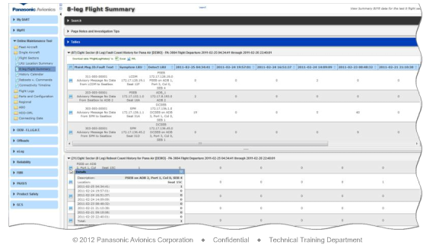
What is DART?
The Data Analysis and Reliability Tool (DART) views and analyzes BITE data to track problem aircraft through a series of reports. It helps access performance issues and troubleshoot maintenance problems.

Slide 2
Applying for the DART Access
DART access is inherited from Panasonic’s MyIFE account, therefore -
For users who are new to MyIFE, go to the MyIFE site (https://myife.panasonic.aero) and request for an account using the “Request MyIFE Membership” entry on the main page.
For users who have received an MyIFE account, go to the DART site (https://dart.panasonic.aero), and log in with the same credential.
When logging into the DART for the first time, your account may not have been enabled properly for your airline’s profile by default. In this case, contact your GCS Account team and provide your login username for configuration.
Your DART account will be properly configured and ready to use within two working days.

